Slide 1
Supply Chain Delivery Performance & Financial Risk Analysis
Adiel Krisnanda Franstito
Identifying Systemic Delivery Delays and Their Financial Impact

Slide 2
Executive Summary
Bullet Points:
57% of total orders experienced late delivery, indicating a systemic supply chain issue rather than a regional problem.
Late delivery rates remain consistent across markets and regions, suggesting structural inefficiencies.
Moderate and high-risk delays generate disproportionate revenue loss, despite lower order volume.
Faster shipping modes reduce delay duration but fail to significantly reduce late delivery rates.
A severity-based prioritization strategy presents the highest opportunity to reduce financial risk.

Slide 3
Business Problem & Objectives
Business Problem
High late-delivery rates negatively impacting customer experience and revenue.
Limited visibility into which delays actually drive financial risk.
Operational decisions are often based on volume, not severity or impact.
Project Objectives
Identify key drivers of delivery delays.
Quantify financial impact of delay severity.
Provide actionable, data-driven recommendations.

Slide 4
Dataset Overview
Dataset : Order-level delivery
Key attributes:
Market & region
Shipping mode
Delivery delay (days)
Delay severity classification
Sales & lost revenue
Analytical Approach :
KPI design using DAX (Late Delivery %, Lost Revenue, Risk Rate)
Segmentation by market, region, shipping mode
Risk classification based on delay severity
Interactive analysis using Power BI

Slide 5
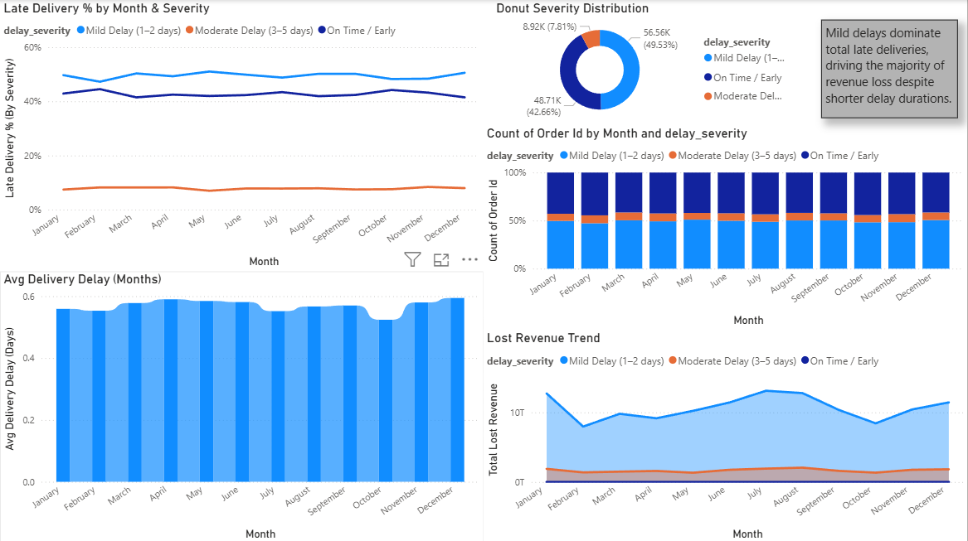
Delivery Performance Overview
Key Takeaways:
Late deliveries account for the majority of total orders.
Volume alone does not reflect financial or operational risk.
Deeper severity analysis is required.
Delivery delays remain consistently high across time, with mild delays dominating in volume but not necessarily in risk.

Slide 6
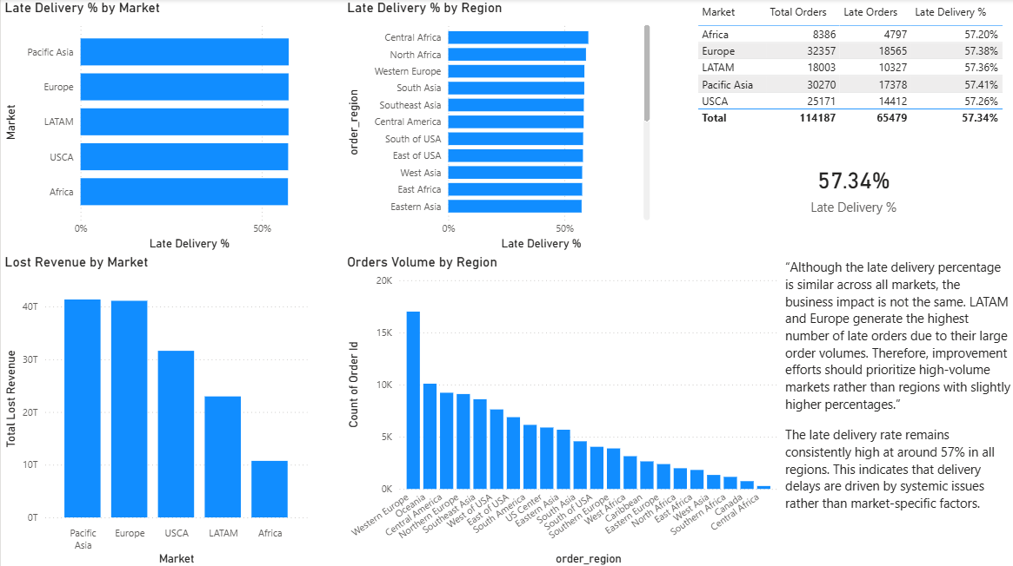
Market & Shipping Mode Insights
Key Insights:
Late delivery is not market-specific.
Regional differences are minimal.
Premium shipping modes reduce delay days but not late-delivery probability.
Market and shipping speed alone do not explain delivery performance issues.

Slide 7
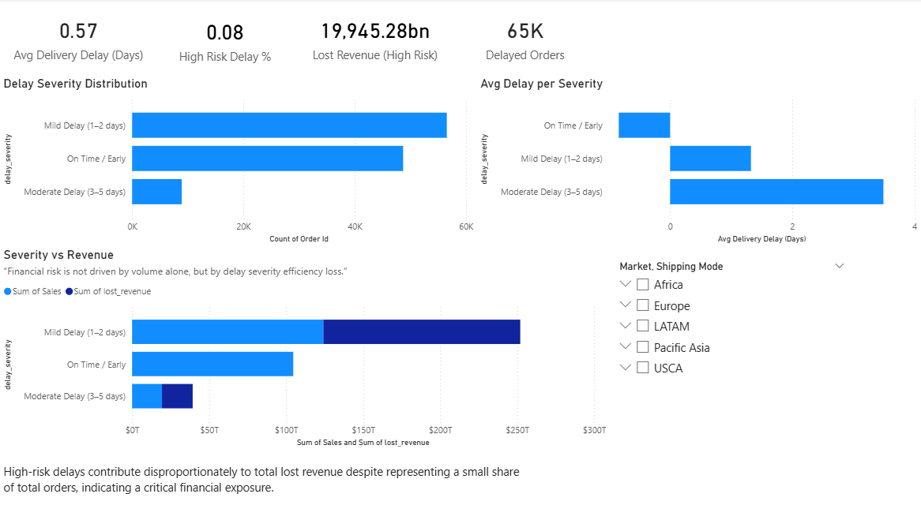
Delivery Risk & Financial Impact
Key Insights:
Moderate and high-risk delays contribute significantly to lost revenue.
Financial impact is driven by severity, not frequency.
Small portions of orders create outsized risk.

Slide 8
Key Business Insights
Revenue loss is concentrated in higher-severity delays
Risk-based analysis provides clearer decision support
01.
02.
03.
04.
Delivery delays are systemic across the supply chain
Improving speed without workflow optimization offers limited benefit

Slide 9
Recommendations & Action Plan
Recommended Actions:
Prioritize mitigation of moderate and high-risk delays.
Re-evaluate shipping workflows, including premium services.
Implement early-warning indicators based on delay severity.
Align operational KPIs with financial risk exposure
Expected Business Impact:
Reduced lost revenue
Improved delivery reliability
Better operational prioritization

Slide 10
Tools, Skills & Value Delivered
Tools & Technologies
Skills Demonstrated
Value Delivered
Power BI
Visual Studio Code
DAX
SQL
Python
Data cleaning
Data modeling & KPI development
Business-oriented analytics
Financial impact analysis
Executive-level data storytelling
Translates operational data into strategic insight
Enables data-driven risk mitigation
Supports informed decision-making

Slide 11
Thank You

